Slide 1
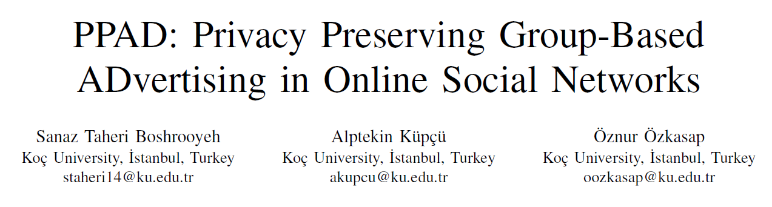
IACR Cryptology ePrint Archive, Volume 2018
Networking 2018

Slide 2



Traditional system
AD Company
User information
Server
User information
Like:Facebook Wechat
Like:Facebook Wechat
information
User

Slide 3



User request system
AD Company
User information
Server
User information
Like:Facebook Wechat
Like:Facebook Wechat
User

Slide 4


Our PPAD
Group
information
AD Company
Group
information
Server
Like:Facebook Wechat
Group
information
information
User1
Group 1:
…
information
PSP
User1
User3
User N-1
Group 2:
…
User18
User6
User18
User N

Slide 5
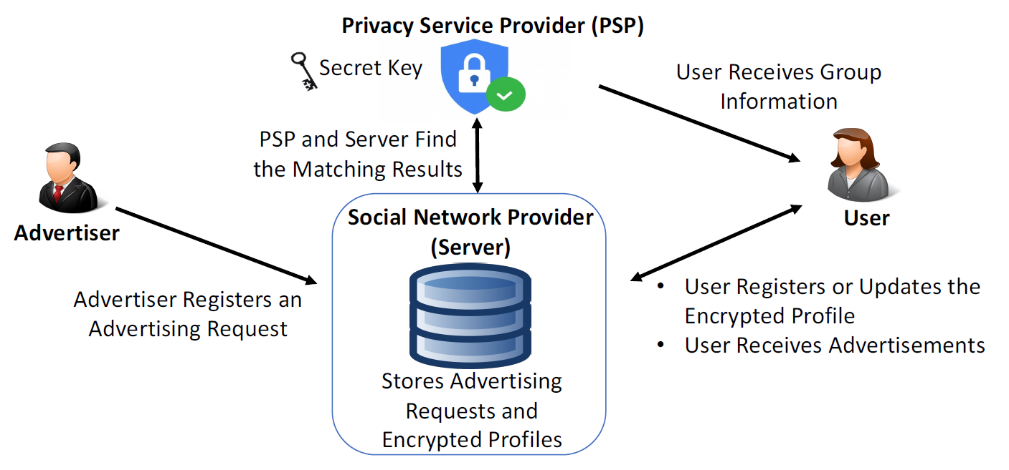
PPAD System Overview

Slide 6
Contributions
提出保护用户隐私的PPAD广告系统，适用于加密用户信息的安全OSN。
与安全匹配要求用户和广告商永久或同时在线的现有解决方案相反，PPAD允许用户和广告商在注册后离线。则在下次它们出现在线时（或通过推送通知等）向相关用户显示广告。

Slide 7

Preliminaries
2, 5, 8, 17, 37, 70, 159, 301
7
15
32
69
139
298
599
Super Increasing Set

Slide 8
Preliminaries
Generate
Hash function
Hash1()
artist
Teachers
Students
Hash2()
Hash3()
Hash4()
Hash1()
Hash2()
Hash3()
Hash4()
0
0
0
0
0
0
0
0
0
0
0
0
0
0
0
0
0
0
0
0
0
1
2
3
4
5
6
7
8
9
10
11
12
13
14
15
16
17
18
19
Bloom filter

Slide 9
Preliminaries
Generate
Hash function
Hash1()
artist
Teachers
Students
Hash2()
Hash3()
Hash4()
Hash1()
Hash2()
Hash3()
Hash4()
0
1
0
0
0
0
0
0
0
1
0
0
1
0
0
0
1
0
0
0
0
1
2
3
4
5
6
7
8
9
10
11
12
13
14
15
16
17
18
19
Bloom filter

Slide 10

Preliminaries
Generate
Hash function
Hash1()
artist
Teachers
Students
Hash2()
Hash3()
Hash4()
Hash1()
Hash2()
Hash3()
Hash4()
0
1
0
0
0
0
0
0
0
1
0
0
1
0
0
0
1
0
0
0
0
1
2
3
4
5
6
7
8
9
10
11
12
13
14
15
16
17
18
19
Bloom filter

Slide 11
Preliminaries
Generate
Hash function
Hash1()
artist
Teachers
Students
Hash2()
Hash3()
Hash4()
Hash1()
Hash2()
Hash3()
Hash4()
0
1
1
0
0
0
0
0
0
1
0
0
1
0
1
0
1
0
0
1
0
1
2
3
4
5
6
7
8
9
10
11
12
13
14
15
16
17
18
19
Bloom filter

Slide 12
Preliminaries
Search
Hash function
Hash1()
artist
Teachers
Students
Hash2()
Hash3()
Hash4()
Hash1()
Hash2()
Hash3()
Hash4()
0
1
1
0
0
0
0
0
0
1
0
0
1
0
1
0
1
0
0
1
0
1
2
3
4
5
6
7
8
9
10
11
12
13
14
15
16
17
18
19
hash function
Bloom filter’s length
False alarm rate
Bloom filter

Slide 13
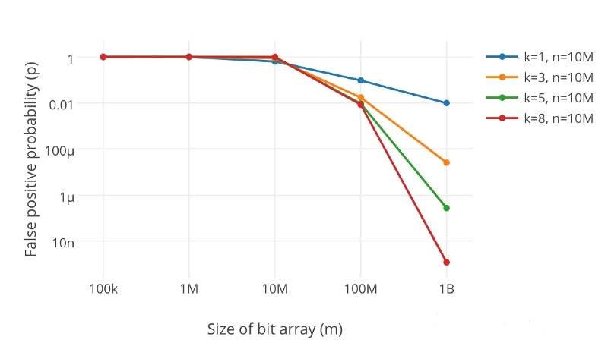
Preliminaries
False alarm rate
k 为哈希函数个数，m 为布隆过滤器长度，n 为插入的元素个数，p 为误报率。
Bloom filter

Slide 14








Target Group
… …
Group1
Group2
… …
GroupN
K users
Group
Threshold = 60% of K users
AD request
{doctor}
{Age >60}
{Artist; Player; Scientist}
No Specific quantity

Slide 15

K users
The group size and threshold are parameters that affect both advertisement accuracy and user privacy.
60% of K users
Server
服务器
Point out
which members
GroupN
Target Group
{Artist; Player; Scientist}

Slide 16


Trust
Server
服务器
Group 1:
…
GroupN
User1
User3
User14
User N-1
…

Slide 17
Advertiser
Req
0
1
1
0
0
0
0
0
0
1
0
0
1
0
1
0
5
User
User 1
0
1
0
1
0
0
1
0
0
0
0
0
0
0
0
0
User 2
0
0
0
0
0
1
0
0
1
0
1
1
0
0
1
0
Group2
User 3
0
1
0
0
1
0
1
0
1
0
0
0
0
0
1
0
K=5 users
User 4
0
0
0
1
0
0
1
0
0
1
1
0
1
0
0
1
User 5
0
1
1
0
0
0
0
0
0
1
0
0
1
0
1
0

Slide 18







Advertiser
Req
0
1
1
0
0
0
0
0
0
1
0
0
1
0
1
0
5
Eg: K = 5
SS {6, 12, 3, -15, 6} sum=0
$D_{i}$1, 8, 64, 512, 4096
User 1
$${Pf}_{j}$$
$D_{1}$=1
0
1
0
1
0
0
1
0
0
0
0
0
0
0
0
0
User 1
6
7
6
7
6
6
7
6
6
6
6
6
6
6
6
6
$D_{1}$=1
${SS}_{1}$=6
${Pf}_{j}$ *$D_{i}$+${SS}_{i}$ =${Pf}_{j}$
i∈[1,k] users
j∈[1,P] bits

Slide 19











$D_{i}$1, 8, 64, 512, 4096
User 1
$D_{1}$=1
${SS}_{1}$=6
6
7
6
7
6
6
7
6
6
6
6
6
6
6
6
6
User 2
$D_{2}$=8
${SS}_{1}$=12
12
12
12
12
12
20
12
12
20
12
20
20
12
12
20
12
User 3
$D_{3}$=64
${SS}_{1}$=3
3
67
3
3
67
3
67
3
67
3
3
3
3
3
67
3
User 4
$D_{4}$=512
${SS}_{1}$=-15
-15
-15
-15
497
-15
-15
497
-15
-15
497
497
-15
497
-15
-15
497
User 5
$D_{5}$=4096
${SS}_{1}$=-6
-6
4090
4090
-6
-6
-6
-6
-6
-6
4090
-6
-6
4090
-6
4090
-6

Slide 20
Req
0
1
1
0
0
0
0
0
0
1
0
0
1
0
1
0
5
User 1
$D_{1}$=1
${SS}_{1}$=6
6
7
6
7
6
6
7
6
6
6
6
6
6
6
6
6
User 2
$D_{2}$=8
${SS}_{1}$=12
12
12
12
12
12
20
12
12
20
12
20
20
12
12
20
12
User 3
$D_{3}$=64
${SS}_{1}$=3
3
67
3
3
67
3
67
3
67
3
3
3
3
3
67
3
User 4
$D_{4}$=512
${SS}_{1}$=-15
-15
-15
-15
497
-15
-15
497
-15
-15
497
497
-15
497
-15
-15
497
User 5
$D_{5}$=4096
${SS}_{1}$=-6
-6
4090
4090
-6
-6
-6
-6
-6
-6
4090
-6
-6
4090
-6
4090
-6
Sum ?
0

Slide 21

Req
0
1
1
7
0
0
7
0
0
1
0
0
1
0
1
0
5
User 1
$D_{1}$=1
${SS}_{1}$=6
6
7
6
7
6
6
7
6
6
6
6
6
6
6
6
6
31
User 2
$D_{2}$=8
${SS}_{1}$=12
12
12
12
12
12
20
12
12
20
12
20
20
12
12
20
12
68
User 3
$D_{3}$=64
${SS}_{1}$=3
3
67
3
3
67
3
67
3
67
3
3
3
3
3
67
3
143
User 4
$D_{4}$=512
${SS}_{1}$=-15
-15
-15
-15
497
-15
-15
497
-15
-15
497
497
-15
497
-15
-15
497
949
User 5
$D_{5}$=4096
${SS}_{1}$=-6
-6
4090
4090
-6
-6
-6
-6
-6
-6
4090
-6
-6
4090
-6
4090
-6
20450
0
21641
Sum ?

Slide 22

PSP
SS {6, 12, 3, -15, -6} sum=0
1
5
✖100%
< 60%
K = 5
sum=0
$D_{i}$1, 8, 64, 512, 4096
sum+1
21641➗ 4096=5… …1161
1161 ➗ 512=2… …137
137 ➗64=2… …9
9 ➗ 8 = 1… …1
1 ➗ 1 =1… …0
21641
5
Res=NO
sum = 1
Threshold = 60%
DB
Server

Slide 23
Server
服务器
GroupN
…

Slide 24








PSP
SS
PK SK
Req
EAggGPf
SS
Res
PK
…
Req
EPf
EPf
…
AD
Group2
Server
K=5 users

Slide 25
PPAD System Overview
PSP
GID 群组ID
UID 用户ID
D Dset D分隔符 每个用户在组中独一无二Dset={$D_{1}，D_{2}$，… ,$D_{k}$} 超增长序列
SS GSS群组秘密共享 GSS={${SS}_{1}，{SS}_{2}$，… ,${SS}_{k}$} sum = 0
PK SK 公私钥
K 群组大小
Req 聚合
5
6
Res
GID UID D SS
1
PK
3
DB Insert(Uname GID Epf Epf帽)
RID 独一无二的请求ID
DB Insert (RID Pname Product Req)
PName 选择一个名字
Product 选择一个产品
Taud 对象属性
Req BF
Pname
Product
Req
2
Uname 一个用户名
AttSet 属性集合
EPf 同态加密的属性
AttSet D SS PK BF
4
Uname
GID
EPf
DB
RID
Advertiser
Server
User

Slide 26
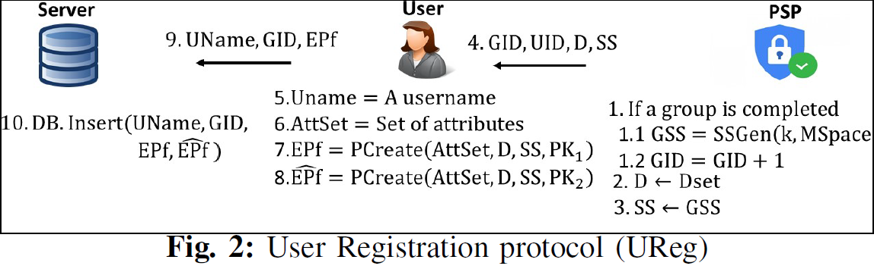
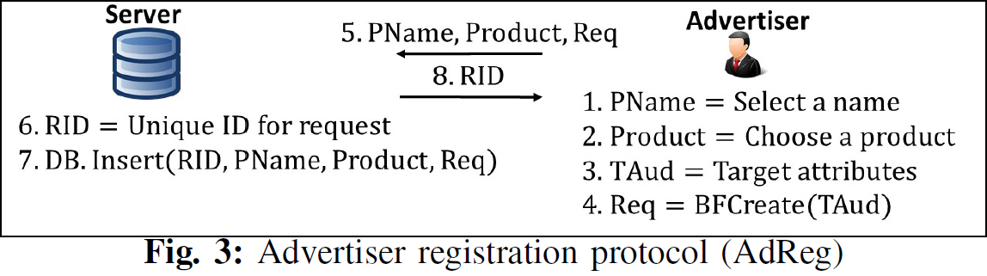

Slide 27
